Slide 1
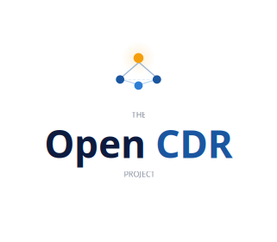
Call Detail Records
for Everyone
An Open CDR
Standard
Building an open, interoperable standard for CDR data —
freely available, community-driven, vendor-neutral.
An open, vendor-neutral schema for
Call Detail Records
Prototype v1.0 | Open Licence | Community Contributions Welcome

Slide 2



THE PROBLEM
CDR formats are proprietary. There is no shared open standard.
Vendor Lock-In
Specialist Tooling Required
Small Business Left Behind
CDR formats differ across every platform. Moving systems or integrating across vendors requires costly bespoke development every time.
Accessing CDR data means buying expensive proprietary software or engaging specialist developers — out of reach for most organisations.
Meaningful call observability, compliance, and audit capability is effectively inaccessible to small and medium-sized businesses.

Slide 3

WHAT IS THE OPEN CDR STANDARD?
A common language for
call data.
{
"callId": "cc2e4b91...",
"callState": "ended",
"mediaType": "voice",
"participants": [...],
"events": [...],
"qos": { ... }
}
A free, open-licence schema defining how Call Detail Records should be structured and exposed — so any vendor, platform, or developer can produce and consume CDR data in a consistent way.
Vendor-neutral by design
Voice, video, chat & email
Multi-party calls native
Full event timeline
OpenAPI 3.1 machine-readable schema
Apache 2.0 — free forever

Slide 4





SCHEMA HIGHLIGHTS
56 Fields
Multi-Party Native
Across 7 structured objects covering every aspect of an interaction
Conferences, transfers, barge-in and silent monitoring as first-class concepts
Full Event Timeline
OpenAPI 3.1
Ordered events array: ringing, hold, IVR, queue, transfer, recording actions
Machine-readable YAML schema with full request/response definitions
Multi-Modal
Extensible
Voice, video, chat, instant message and email interactions all in scope
vendorSpecificFields allows platforms to add metadata without polluting the core

Slide 5



WHO WE ARE
Built by practitioners,
for the industry.
Industry professional with hands-on experience across telephony, call recording, and call recording compliance
Worked across multiple platforms, vendors, and regulatory compliance frameworks
First-hand experience of the integration friction caused by the absence of a CDR standard
This is not a commercial project — no product to sell, just a genuine problem worth solving

Slide 6
PROJECT ROADMAP
NOW
NEXT
GOAL
Phase 1 — Prototype
Phase 2 — Industry Sponsorship
Phase 3 — Realised Standard
CDR field schema defined
OpenAPI 3.1 published
Example call records
Open-licence release
Vendor engagement
Working group formation
Schema peer review
Formal endorsement
Stable v1.0 specification
Active contributor community
Native vendor adoption
Certification programme

Slide 7

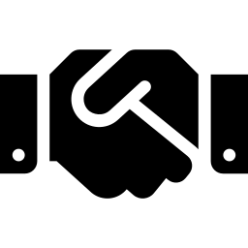

MONETISATION & SUSTAINABILITY
Open source standard.
Sustainable ecosystem.
While the schema itself remains free and open. The ecosystem around it could create sustainable revenue streams without compromising the standard's neutrality.
Vendor Certification
Industry Sponsorship
Paid Software

Slide 8
GET INVOLVED
This standard becomes
meaningful with your input.
Review the schema
Raise issues
Does it cover your platform's data? What is missing or ambiguous?
Flag gaps, propose additions, or challenge assumptions via GitHub issues.
Submit a pull request
Sponsor or endorse
Propose changes to the schema, field definitions, or example records.
Bring your organisation's weight behind a standard the industry needs.
The Open CDR Project | Apache 2.0 Licence | Community Contributions Welcome | Prototype v1.0

